Slide 1

A Day in the Life of Quang
Quang Huynh
Sociology
3/28/22

Slide 2
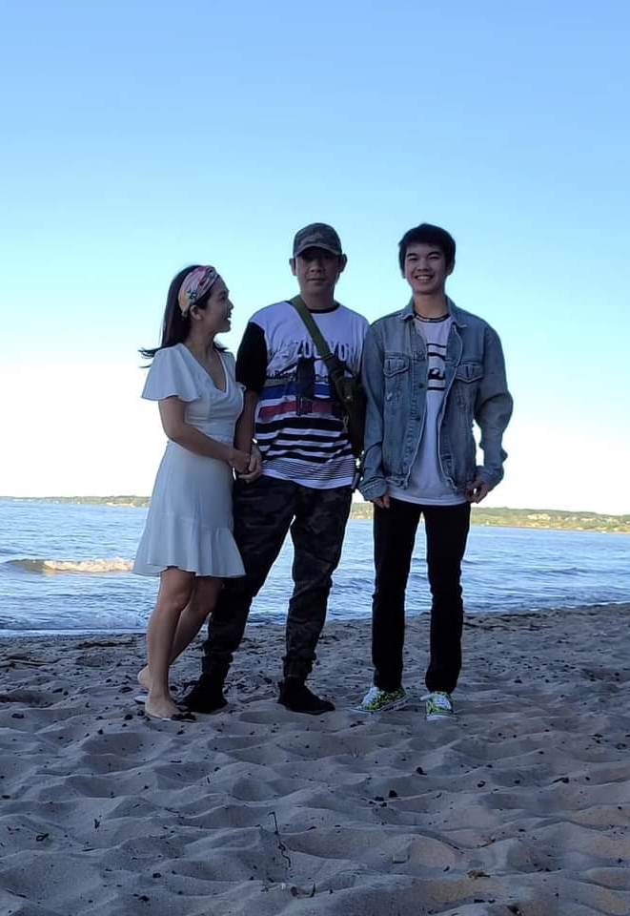
Family
In what ways are you expected to show respect for your parents? Some ways I am expected to show respect for my parents is doing chores and being kind to them.
What are the different roles for sons and daughters? I don’t have a sister, but my role is to do chores and occasionally cook dinner.
How much of your successes and failures are due to your parents? A lot of my successes such as my work ethnic and mannerisms are due to my parents. There are some failures, such as being impulsive, but I cannot owe that due to my parents.
How much input do you have in important family decisions? My input on important family decisions have a medium impact. I am heard, but sometimes they do not follow through with my decision.
Do you consider your parents your friends? Yes, they are great to talk to and are always there for me. I can talk to them whenever I want, and they go to me for opinions on things.
What are the most important values that your parents want to instill in you? Some of the most important values that my parents want to instill in me are respect and being self-sufficient.
What is a typical family vacation like? A typical family vacation involves going to Vietnam or going to a local amusement park or zoo.
What are the topics of big disagreements you have with your parents? A topic of big disagreement that I have with my parents is about COVID-19 and how safe we need to be.

Slide 3
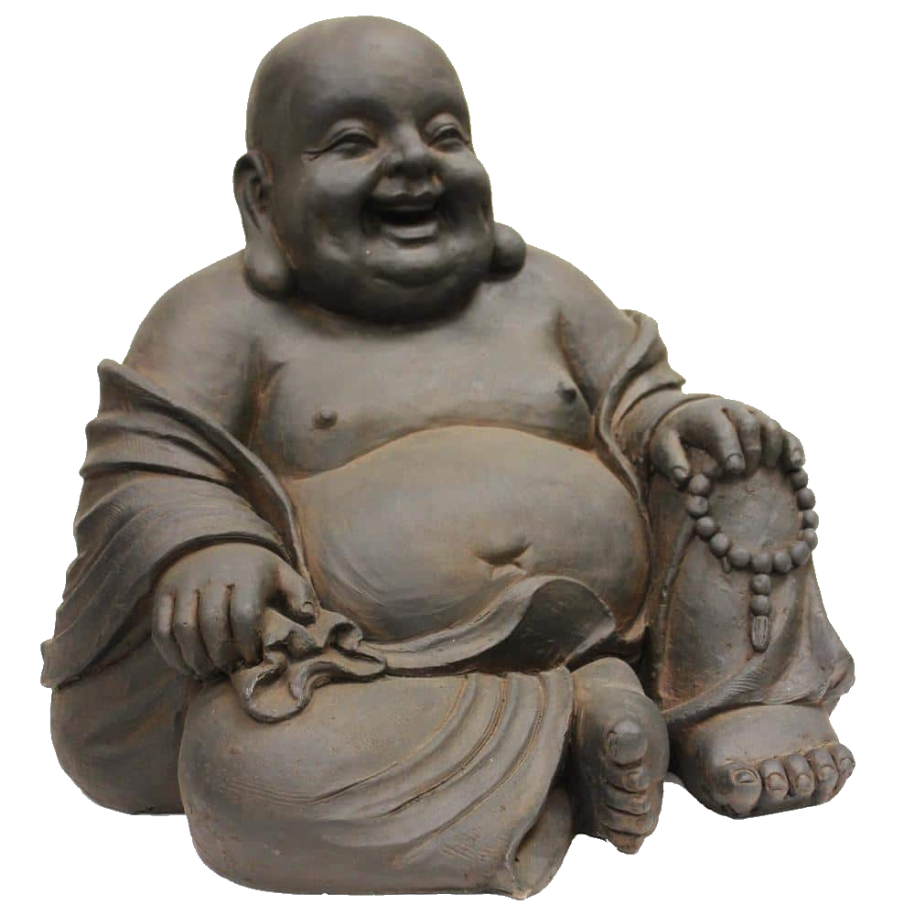
Religion
How important is the role of religion in your upbringing? The role of religion in my upbringing was somewhat important. I had to pray and go to temples on my own volition.
Do you practice religious customs in your daily life? Yes. I occassionally pray to the Buddhist gods in our living room.
If so, explain what religión you are and the religious practices you follow. I am a Buddhist and I have to follow a conduct of having good virtues and being kind.

Slide 4

Community
What are the biggest dangers to you as a teenager? As a teenager, I believe the biggest danger is following bad trends and being friends with the wrong people.
What are your future aspirations/goals after adolescence? How possible did you believe these goals were? A goal of mine after adolescence is to do something that I would be happy and content in. I think it is very possible for me to find something I enjoy, although it may take more than I would expect.
What are your greatest sources of stress? My greatest sources of stress is from school and having too high expectations for myself.
Do you volunteer in your community/school? In what ways? Yes. I am a member of the National Member Society and I volunteer around the school and community through NHS.

Slide 5
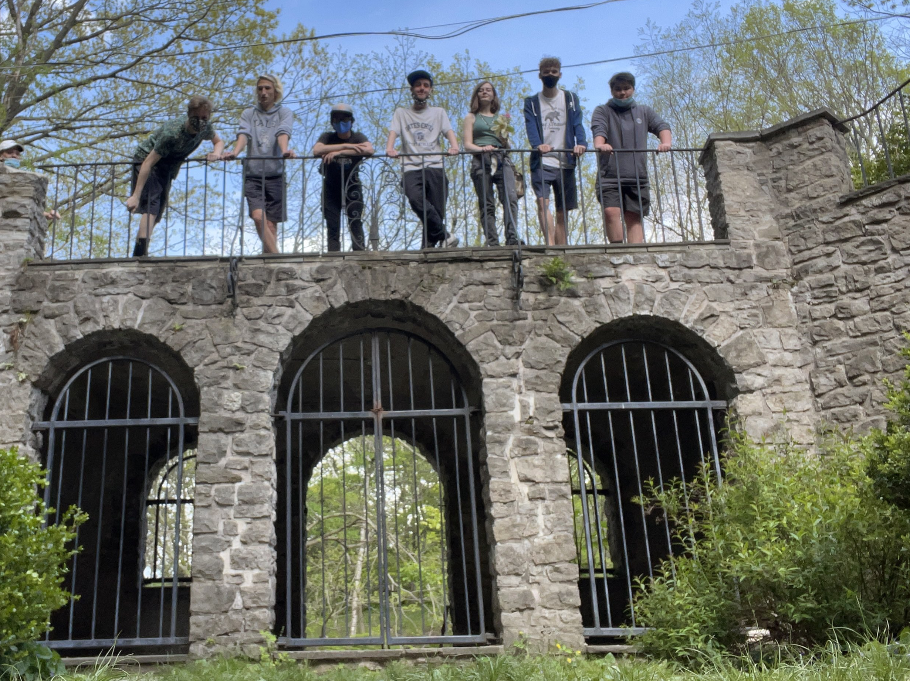
Peers
What percent of your time is spent with your peers? Almost 90% of my time is spent with my peers at school. I usually hang out with my friends afterschool and during the weekend. Then, at home, I would be in a call with them and play videogames together.
What do you do for fun? For fun, I work on cars, hang out with friends and play videogames.
How do you spend your free time? In my free time, I listen to music or watch videos online.
Who has a stronger influence on your life: peer group or family. Why? I believe family had a stronger influence on my life during my upbringing. But now, I think my peer group has a bigger influence since I am always around them.

Slide 6
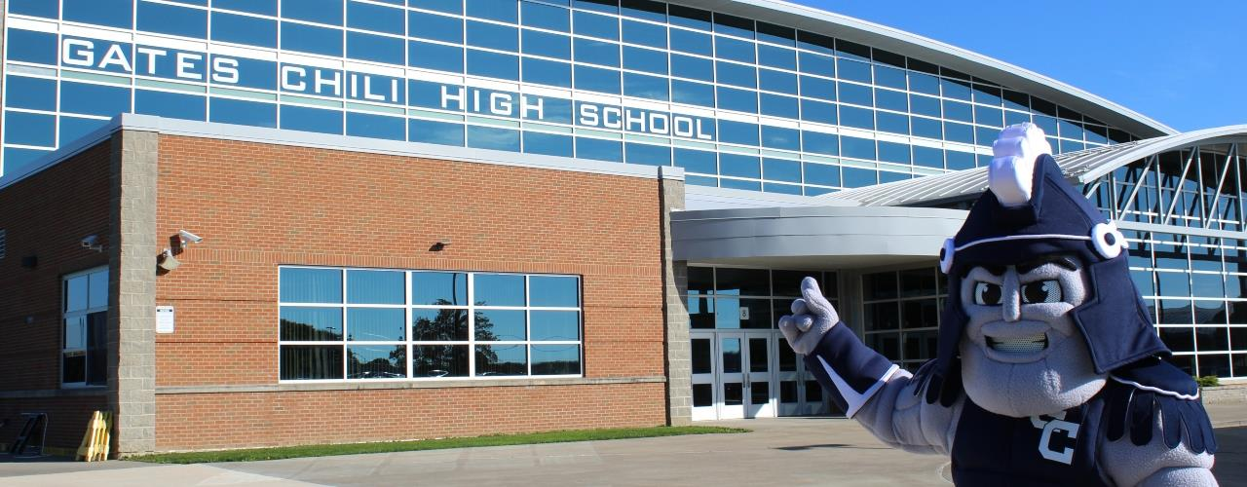
Education
What is a typical school day like? A typical school day goes by fast and to be honest, a typical school day is tedious and repetitive. It’s practically the same thing everyday.
How much homework do you spend doing? I spend around an hour or two doing homework every night and it is very boring.
How important is a high school diploma to you? A high school diploma is important to me, but not as important as a degree in college.
What extracurricular activities are you involved in? I am involved in doing sports such as soccer, track and field, cross-country and NHS.
What kind of things were you interested in during elementary school? In elementary school, I was interested in video games and running.
Do any of your teachers influence you? If so, explain how? Yes. The wise teachers who I believe are knowledgeable and funny, I enjoy listening and learning from them. Some teachers inspire me while some teachers actively show that they enjoy their job and that motivates me.
Do you play sports? If so, which one and why? I play many sports, but a primary sport of mine is track and field. As a kid, I always liked running and I decided to try it out in middle school. I enjoyed track and field in middle school, but due to COVID and everything, track and field during high school was not as fun.

Slide 7

Mass Media
What is your favorite TV show? Why? My favorite TV show is Invincible due to the amazing story and animation. Everything was well put together and I loved it. Waiting for the season 2.
What are your major sources of information for the news? My major sources of information for the news are through friends or through google news.
What is the coolest or most trendy technological gadget of your time? I think the coolest technological gadget of my time are graphic cards. They’re getting more powerful every year and visuals in general. Technologically, everything is growing at an exponential rate.
Who is your most favorite celebrity? Why? Currently, my favorite celebrity is Dwayne “The Rock” Johnson due to his personality.

Slide 8
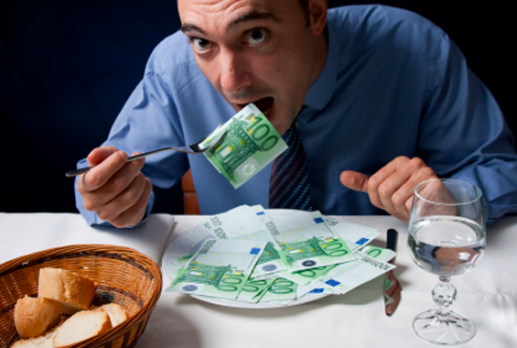
Economics
How important is it to you to be wealthy? For me, being wealthy is not that important. I think it’s more important how I feel emotionally and physically.
What is your view on debt? (owing money or not having enough money) I think debt isn’t that difficult to pay off. If you save enough money and gradually pay it off, the debt will evaporate sooner than later. I don’t get why people just spend their money impulsively and not on important things like paying off debt.
What do you think your future financial success will be like? I think my future financial success would be better than average. I believe I’m a good spender and good saver when dealing with money. Furthermore, I would like to get into college and find a good job.
Will it be better, the same, or worse than your parents? I think my future financial success would be better than my parents since they did not have a college education and moved to America with little money.
What will you spend your money on in the future? I will spend my money in the future for essential things, such as groceries, bills, payments, etc. I will have limited subscription services and put excess money in a savings account.

